Slide 1
BottleBats 2.018

Slide 2
BottleBats 2.018
What is?
2nd edition of AI competition for dummies
-
battle friends and foes
-
social tinkering and theorycrafting
-
live tournaments

Slide 3
BottleBats 2.018
How does it work?
Game
State
Bot
(you!)
Actions
stdin
stdout
Turn

Slide 4
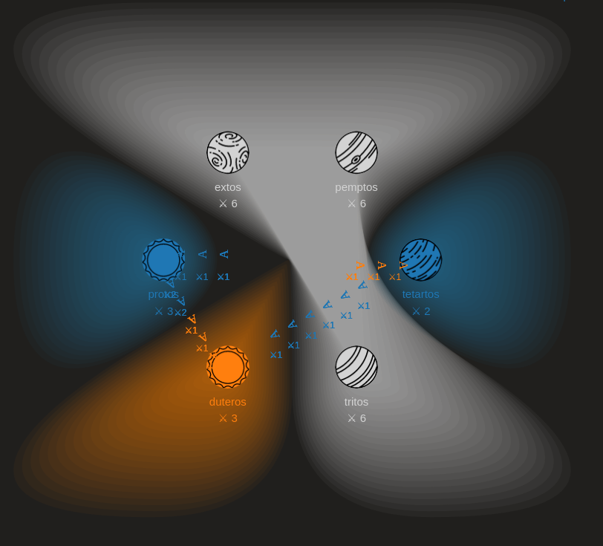
PlanetWars
What is?

Slide 5
PlanetWars
Rules
turn-based
planets on a 2d plane
players command a fleet of spaceships
players can occupy planets
each turn, an occupied planet constructs a new ship for its owner
spaceships travel time is proportional to the euclidean distance
combat happens on planets only

Slide 6
PlanetWars
Turn procedure
ship construction
dispatches
combat resolution

Slide 7
PlanetWars
Combat resolution
fleets belonging to the same player are merged
each ship destroys one ship in all other fleets
this means the largest fleet wins, with |fleet| - |second largest fleet| ships remaining

Slide 8
PlanetWars
How to win
The last player standing wins!
When the turn limit is reached, all remaining players tie.

Slide 9
Bot Writing
Interaction with the game
Game
State
Bot
Actions
stdin
stdout

Slide 10
Bot Writing
Interaction with the game
Game
State
Bot
Actions
stdin
stdout
Format: line-separated JSON
(one line for each turn)

Slide 11
Bot Writing
Game state
{
“planets”: [
...
],
“expeditions”: [
...
]
}

Slide 12
Bot Writing
Game state: Planet format
{
“name”: “my cool planet”,
“x”: 42,
“y”: 42,
“owner”: 1,
“ship_count”: 23
}

Slide 13
Bot Writing
Game state: Expedition format
{
“id”: 1000,
“origin”: “my boring planet”,
“destination”: “my cool planet”,
“turns_remaining”: 3,
“owner”: 2,
“ship_count”: 18
}

Slide 14
Bot Writing
Game state: Players
Player numbers are rotated so that you are always player 1.
Note that they are 1-based.
Neutral planets exist, they don’t have an owner (not in JSON, null, …)

Slide 15
Bot Writing
Sending commands
{
“moves”: [
...
]
}

Slide 16
Bot Writing
Sending commands: Move format
{
“origin”: “my boring planet”,
“destination”: “my cool planet”,
“ship_count”: 23
}

Slide 17
Bot Writing
What can go wrong?
invalid commands are ignored by the game implementation
if your bot crashes, the game will halt.
Your bot is allowed one second to compute its turn.
For now, this is considered an error (like a crash).

Slide 18
BottleBats 2.018.1
What does the future hold?
We’ll keep updating the game software throughout the semester
We hope to release networking support after easter break

Slide 19
BottleBats 2.018.1
Upcoming events
Live tournaments
Collective tinkering / theorycrafting / coding sessions

Slide 20
BottleBats 2.018.1
We’ll keep you posted!
https://bottlebats.zeuswpi.org/

