Slide 1


Slide 2
De Kelder
zeus.gent

Slide 3
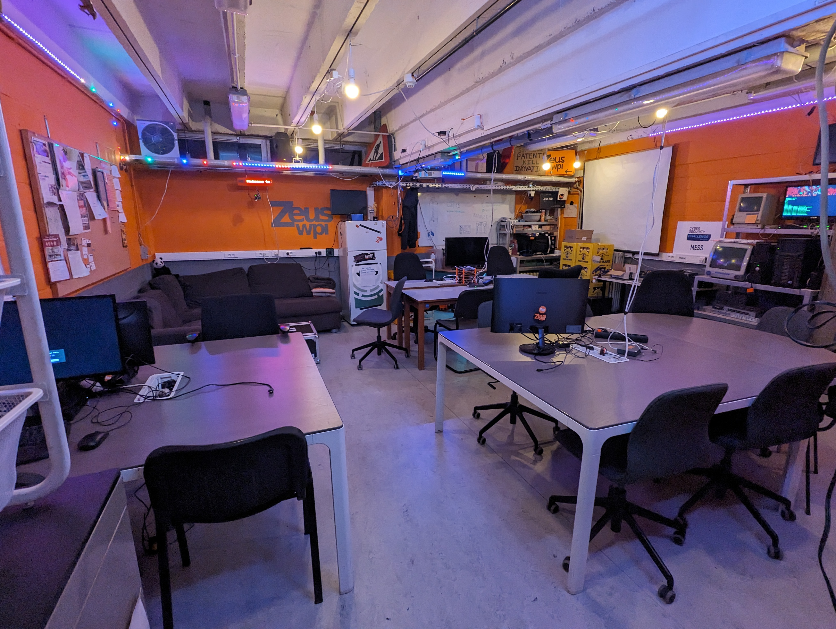
zeus.gent

Slide 4
Events
zeus.gent

Slide 5
08/10 NERF Fight
11/10 Esoterische & Frustrerende codenight
17/10 Hacktoberfest codenight
27/10 Lan party
...
zeus.gent

Slide 6
Projects
zeus.gent

Slide 7


Hydra
12 Urenloop
zeus.gent

Slide 8
Skireis
zeus.gent

Slide 9


zeus.gent

Slide 10
ski@zeus.ugent.be
zeus.gent

